Slide 1
Random Forests

Slide 2
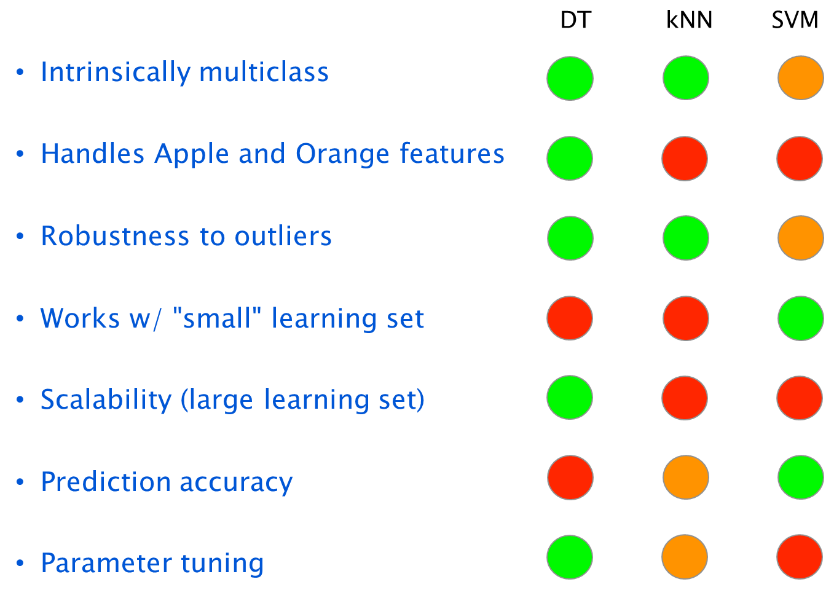
Decision Tree

Slide 3
Bagging of Decision Trees
Why just one tree?
  Final prediction is the mean prediction (regression) or class with maximum votes (classification).
Training data
Bootstrap
Samples*
Decision
Trees
*samples equal in size to the original dataset, but selected with replacement

Slide 4
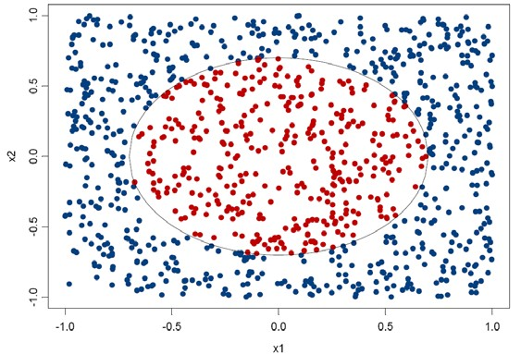
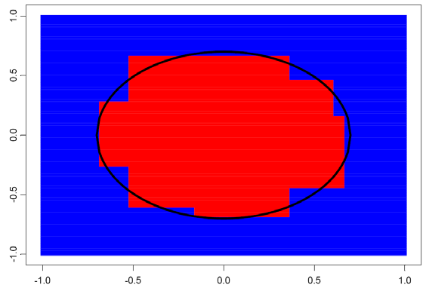
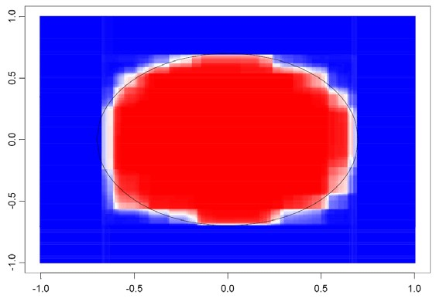
Bagging of Decision Trees

Slide 5
Bagging of Decision Trees
Bagging = bootstrap aggregation
  Create multiple models with bootstrap
    Create new training sets with bootstrap samples
    Create models with each samples
  Aggregation
    Averaging or major voting of the models
Advantage of Bagging
  Decreasing test error by lowering prediction variance while leaving bias unchanged

Slide 6
Random Forests
Bagging of DT + Additional Randomness
Training data
Bootstrap
Samples
Creating
with addtional randomness
Decision
Trees
Corelation between trees are reduced by randomness

Slide 7
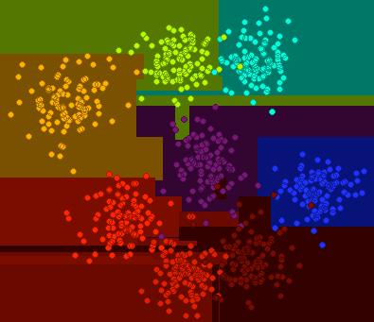
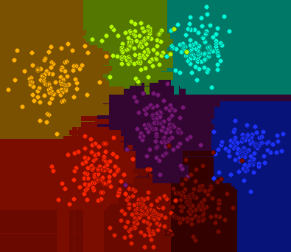
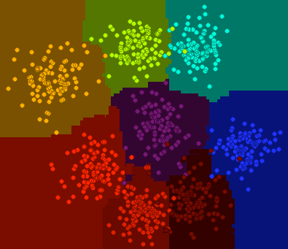
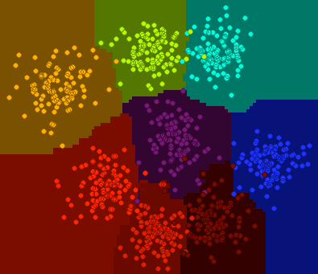
Random Forests
Illustration
1 rCART
10 rCARTs
100 rCARTs
500 rCARTs

Slide 8
Advantages
Overall
  For many data sets, it produces a highly accurate classifier. (Almost same as SVMs and NNs)
  It is faster to train and has fewer parameters than SVMs and NNs (good for large databases)
  It is interpretable
Training
  It generates an internal unbiased estimate of the generalization error (Cross validation is unnecessary)
  Resistance to over training

Slide 9
Advantages
Data
  Ability to handle data without preprocessing
  Data does not need to be rescaled, transformed, or modified
  Resistant to outliers
  It can handle thousands of input variables without variable deletion (Good for problems where k>>N)

Slide 10
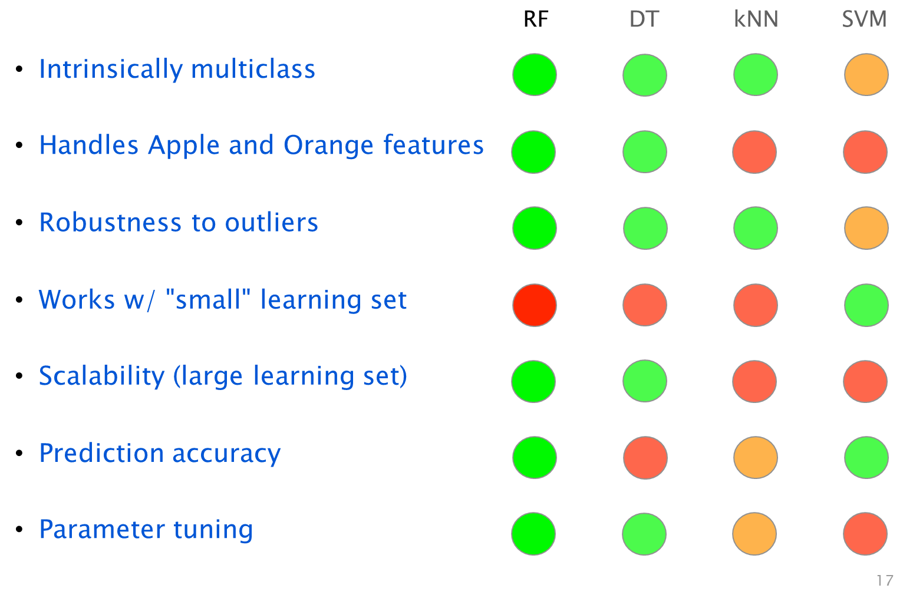
Comparison

